Slide 1

Locust Framework

Slide 2

Agenda
Introduction to the Locust Framework
Basic Concepts of the Locust Framework
Key Features of the Locust Framework
Benefits of Using the Locust Framework
Getting Started with the Locust Framework
Writing and Running Test Scenarios with Locust
Analyzing and Interpreting Test Results with Locust
Real-time Monitoring and Reporting with Locust

Slide 3

Introduction [definition, Purpose, Example, release, Version]
Locust is an open-source load testing tool used to measure the performance and scalability of web applications. Locust framework is powered by Python, a popular programming language known for its simplicity, readability, and flexibility.
Purpose: Load testing is important to detect and fix performance issues before they become critical and impact user experience.
Example: When a website crashes or becomes unresponsive during a sale, it can result in lost revenue and negative customer feedback.
Release: Locust was first released in 2011.
Version: 2.15(latest)

Slide 4
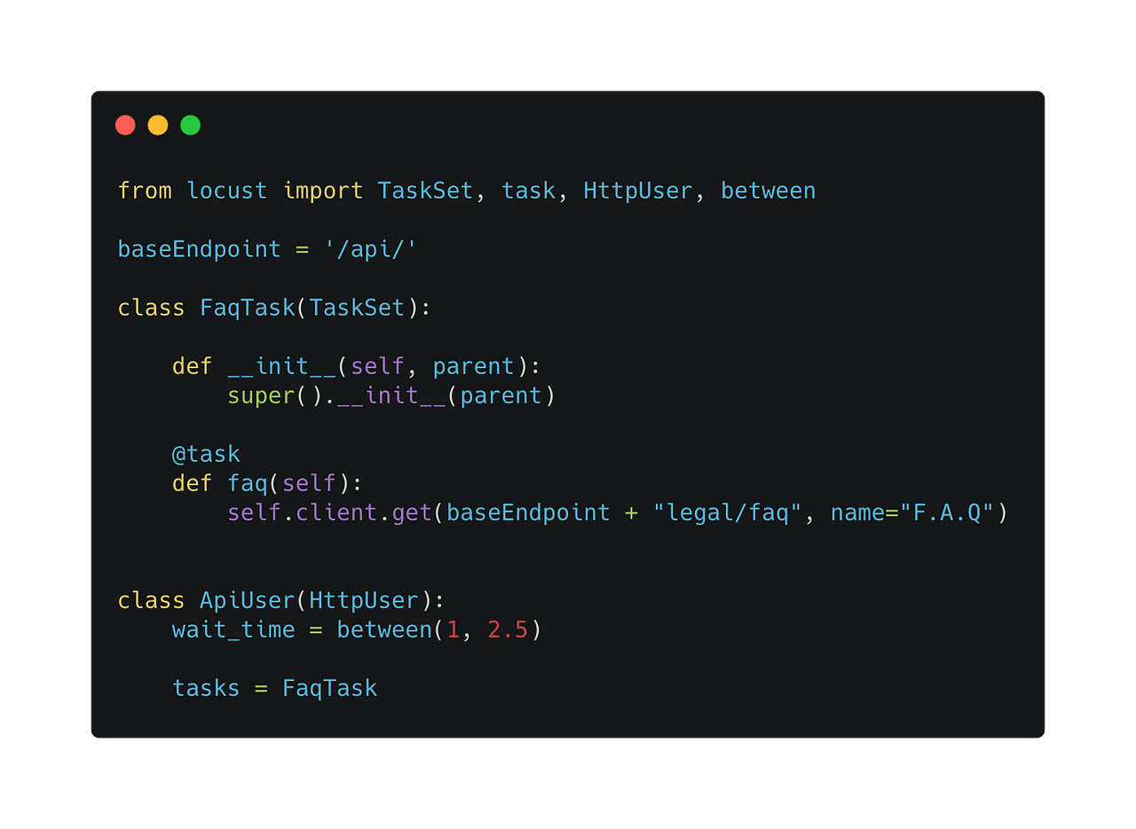
Basic Concepts
Locust framework is like a testing tool that helps website developers make sure their website works well when lots of people visit at the same time. It does this by pretending to be lots of people visiting the website all at once, and checking if everything works as expected. It's like having a big group of people try to use the website all at once, to make sure it doesn't break. The tool is free to use and helps developers find and fix problems before real people experience them.

Slide 5
Key features
Scalable load generation: The framework is capable of simulating thousands of concurrent users to generate a realistic load on the website.
Distributed load testing: The framework can run on multiple machines simultaneously to test the website's scalability.
Scripting flexibility: The framework uses Python, a popular and flexible programming language, to write test scripts.
Real-time monitoring: The framework provides real-time monitoring of test results and metrics, including response times, failures, and other important performance indicators.
Web-based user interface: The framework has a user-friendly web-based interface that makes it easy to create and run load tests, as well as monitor results.
Open-source: The framework is open-source, meaning it's free to use and can be modified and customized to suit individual needs.
Easy integration: The framework can be easily integrated with various tools and technologies, including Continuous Integration (CI) systems, to automate the testing process.

Slide 6
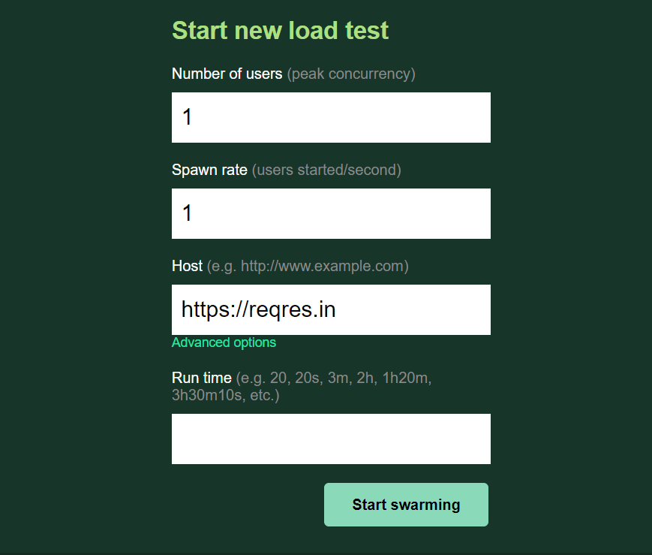
benefits
Cost-effectiveness
Realistic testing
Easy-to-use interface
Flexible scripting
Real-time monitoring
Integration with other tools

Slide 7
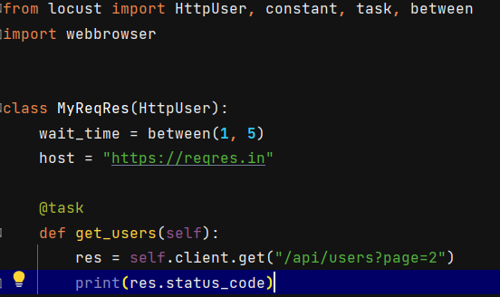
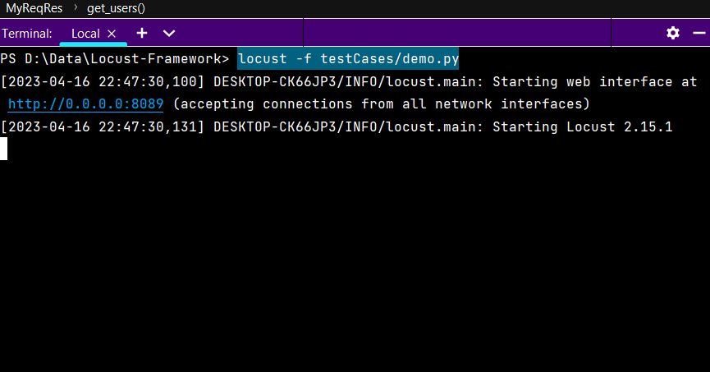
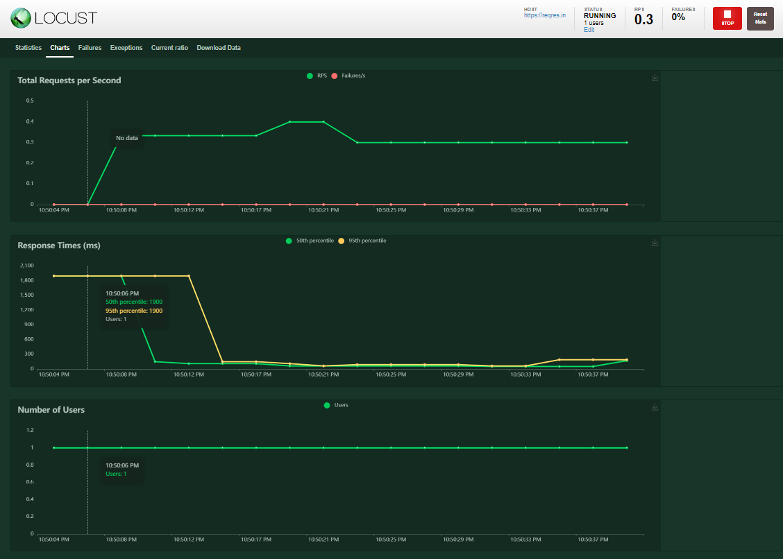
Locust installation How to start with locust ?
Install Python
Install Locust – pip install locust
Writing a Test Script
Starting the Locust Server – localhost:8089
Running the Test

Slide 8
Analyzing and interpreting test results
Access the Results: After running a test, Locust provides an interface to view the results. You can access this by opening a web browser and navigating to the address http://localhost:8089.
View the Metrics: The Locust interface displays various metrics related to the test, including the number of requests made, the number of successful requests, the response time, and the failure rate.
Generate Graphs: Locust can generate graphs to visualize the test results. You can view these by clicking on the "Charts" tab in the Locust interface.
Identify Performance Issues: Look for any spikes or anomalies in the graphs or metrics that indicate a performance issue. Identify the causes of any such issues and try to optimize the code to resolve them.
Refine the Test: Based on the results, refine the test to better simulate real user behavior or to focus on specific parts of the website that need further testing.
Re-run the Test: Once the issues are resolved, run the test again to see if the improvements have made a difference.

Slide 9
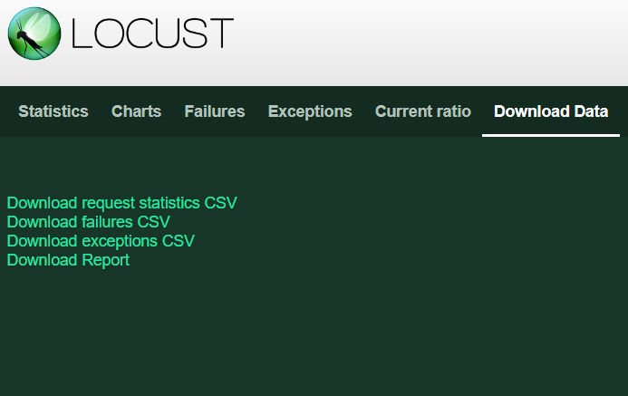
Real-time Monitoring and Reporting
Running the Load Test
Monitoring the Results in Real-Time
Generating Reports
Analyzing the Results
Refining the Test
Re-Running the Test.

Slide 10
Locust & JMeter (difference between locust & JMeter)
Language: JMeter is written in Java, while Locust is written in Python. This means that JMeter requires a Java Runtime Environment to run, while Locust only requires Python.
User interface: JMeter has a graphical user interface (GUI) that allows you to create and manage test plans, while Locust uses a script-based approach that requires you to write Python code to define your test scenarios.
Test scenarios: JMeter is better suited for testing complex scenarios that involve multiple protocols and systems, while Locust is designed for testing web applications and services.
Scalability: Locust is designed to be highly scalable and can simulate millions of users, while JMeter can struggle to handle large test scenarios.
Real-time monitoring: Locust provides real-time monitoring and reporting of test results, while JMeter requires you to manually analyze the test results.

Slide 11
Conclusion (Why the Locust Framework is Essential for Load Testing and Performance Optimization ?)
The Locust framework is a tool that helps you test how well a website or web application works when lots of people are using it at the same time.
Locust can mimic how people use a website, so you can see how it performs under different conditions and fix any problems before they happen.
With real-time monitoring and reporting, Locust can help you quickly find and fix any issues that might slow down or break your website.
By using Locust, you can make sure your website works well for lots of people at the same time, so they can all have a good experience using it.
Overall, Locust is an important tool for anyone who wants to ensure their website can handle many visitors without any problems, and provide a great user experience for everyone.

Slide 12

Any
Questions
?

Slide 13


